Slide 1
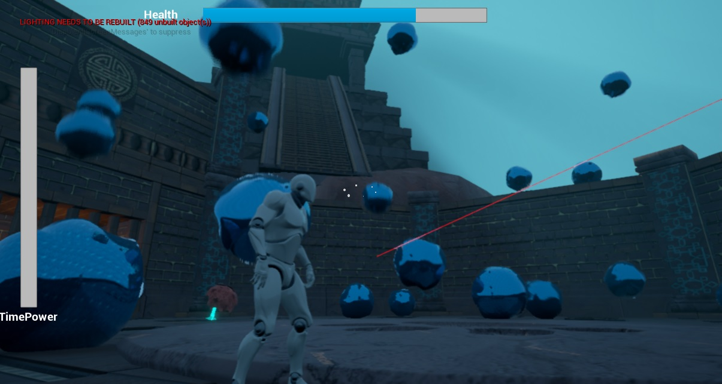
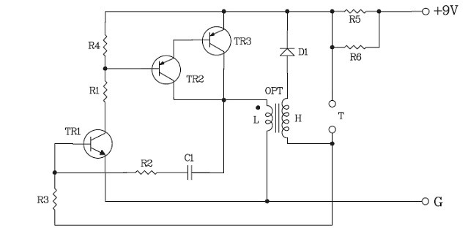
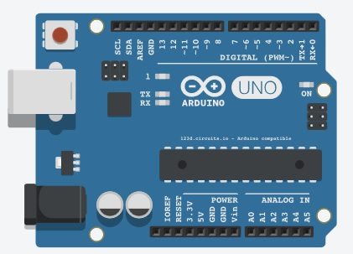
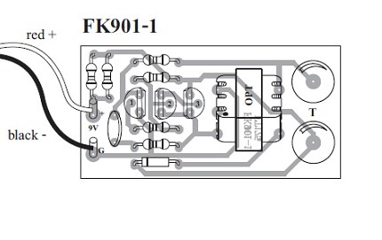
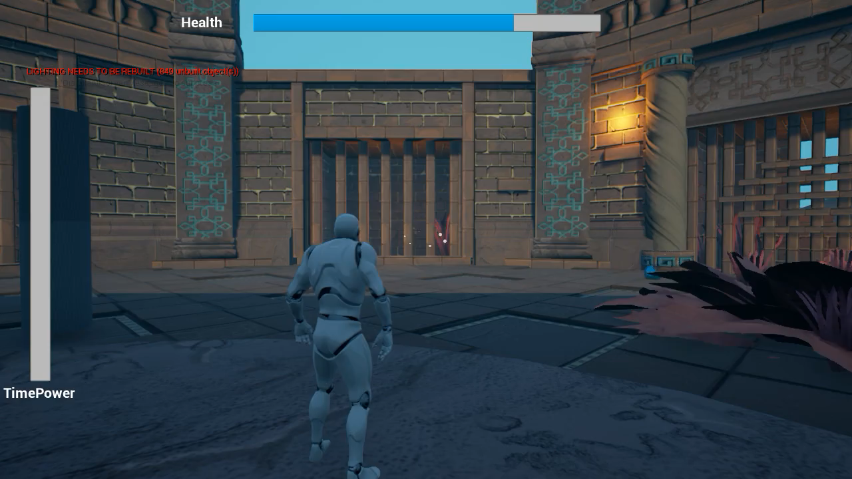
COMP 210 Interface and Interactions
Assignment 2
1506530
Images sourced from https://store.qkits.com/electric-shock-kit-fk901.html
And
https://circuits.io/circuits/3423663-the-unnamed-circuit/edit#breadboard
For my VR assignment I propose a controller interface that takes a basic VR game and add some haptic feedback. This will be done by using an Arduino along with some circuitry and shock pads.
The basic game concept is to run around an arena while avoiding falling electrified water, if you get hit by one you will get shocked, literally. The implementation into VR should be simple as Unreal comes with many Plugins for VR which allow for quick setup. The movement controls will be applied to a gamepad.
This is the concept for the circuit that will be built. A 9V power supply will be attached to a few transistors and a coil to increase the voltage given. This should be enough for the player to feel uncomfortable but not hurt. The shock pad will be attached to the players hands.
Shock Pad
Shock Pad
Shock Pad
Adding the Arduino will allow the game communicate with the shocker. A simple serial output will be used. So when the player runs into a water orb they the game will send a signal to the Arduino to send a current through the shock pads.
A small example of how the electrified water will work and the notification you get for when the player gets shocked. If the video is not available then please look at the attached video in the Zip folder.

